Slide 1
STEM Information Meeting

Slide 2
STEM Board
President: Swetha Thagella
Vice President: Andi Moss
Treasurer: Kristin Kenny
Tech Support and Member at Large: Anusha Arun
Randall STEM Team Lead and Member at Large: Stevie Hodgkins

Slide 3
Parents we have a FB page!
Search Randall Middle School STEM club.
Answer ALL the questions, this is how we control SPAM on our page.

Slide 4
STEM Academy
Academy will be on THURSDAYS at 8:20am
Academy is open to ALL
Dues are $45 and will include a STEM t-shirt
Students will be able to choose ONE academy class in the fall and a DIFFERENT academy class in the spring.
Each Club meets twice a month. There will be PURPLE days and WHITE Days
Students will either pick a purple OR a white club

Slide 5
Purple Day Clubs
Dates: Sep 12th, Sep 26th, Oct 10th, Oct 24th, Nov 7th, Nov 21st
Graphic Design – Hodgkins
ExoNaut (Replacing Spheros)– Sampson
Animal Allies – DeDea
Chess - Nowry

Slide 6
White Day Clubs
Dates: Sep 19th, Oct 3rd, Oct 17th, Oct 31st, Nov 14th, Dec 5th
Rockets – Hodgkins
Mircobiology – Rupe
Rubik's Cubes – Snyder
Lego Creations – Stephen
STEM Art - Daniels

Slide 7
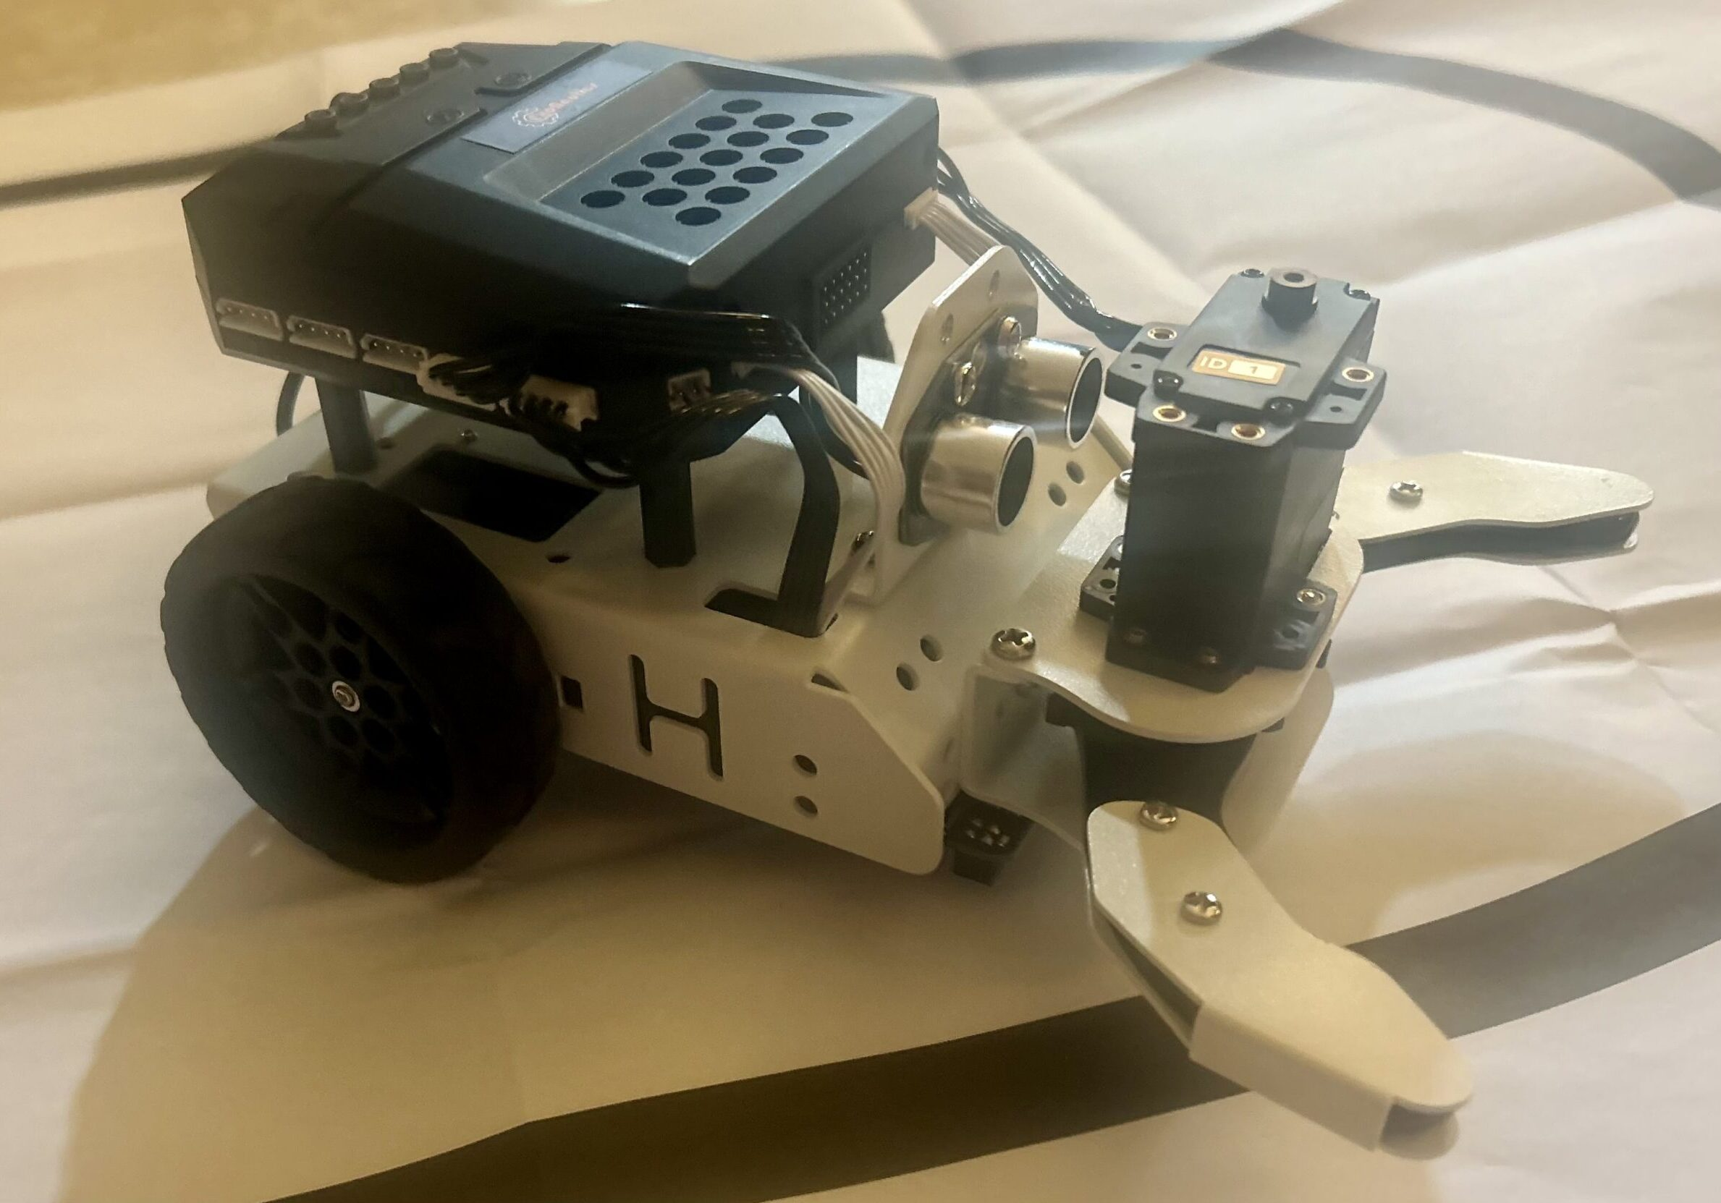
ExoNaut with Ms. Sampson
Students will work on programming ExoNauts robots We will focus on a text programming toward utilizing Robot-C to program and real robots to accomplish specific objectives.

Slide 8
Chess with Ms. Nowry
Knights, Rooks & Pawns...all require fortitude!
Do you have the strategies of putting the King in Check? Then STEM Chess Club might be the right move for you!
Dare to challenge fellow students in a brain match like Chess, which requires resilience, perceptive tactics, and problem-solving scenarios for the ultimate reward!

Slide 9
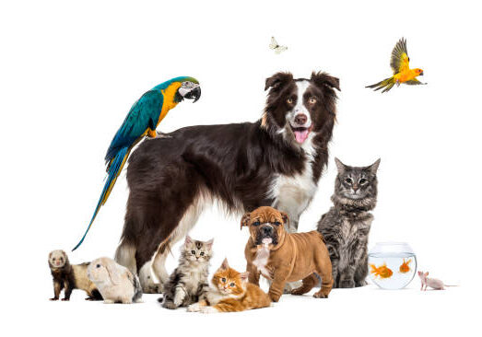
Animals Allies with Ms. DeDea
Do you love animals and want a unique way to help them?
Animal Allies is a brand-new academy club that uses crochet, which involves abstract thinking, problem solving, and designing, to help animals in need.
Students will be able to choose the charities they want to make creations for, from animal shelter blankets to Joey pouches!
No prior experience needed!

Slide 10
Graphic Design with Ms. Hodgkins
Do you love to create? Learn the basics of Canva, where the possibilities are endless! At the end of the semester, students will be able to print their own creations to make a gallery.

Slide 11
LEGO Creations with Ms. Stephen
If you love working with others and building with Lego, then Lego Creations is for you!
Lego Creations students will be able to collaborate with others to build wonderful Lego creations. They will become Lego masters and be able to let their own imagination run free!

Slide 12
Rubix's Cubes with Ms. Snyder
For those who love to solve puzzles with a twist! It doesn't matter if you been solving cubes for years or have never solved one/ All are welcome to try the classic and new shapes!

Slide 13
Microbiology with Ms. Rupe
See and discover the hidden world of microorganisms.
Students will learn how to use basic and advanced microscopes to study and understand the world they could not see until now!
**This course is for beginners and not recommended for students who have advance knowledge of microscopes.**

Slide 14
Rockets with Ms. Hodgkins
Come design, engineer, and compete with your creation!
​Teamwork is a skill that they acquire and they organize into a group with many specialized responsibilities for the purpose of launching their rockets and collecting valuable data to be processed and analyzed in the classroom. Suddenly, the Pythagorean Theorem makes sense as they visualize the giant triangle formed by the flight path of their rocket. Newton's Laws are in full enforcement right before their very eyes. Through the activities of model rocketry, science and math not only exist, they “come to life.”
Suggested for grades 6th & 7th

Slide 15
STEM Art with Ms. Daniels
Discover the Intersection of Art and Technology in STEM Art! Are you ready to unleash your creativity? Join our exciting new class, STEM Art, where imagination meets innovation! Explore the fascinating world of STEM Art, where circuits, projection, light, and geometric shapes converge to inspire awe-inspiring creations.
Don’t miss out! Sign up now and let your imagination soar!

Slide 16
STEM Competitive Teams
Students must attend an information meeting and take a test.
Students may be a part of Thursday Academy, but it is not a requirement
IF selected there is an additional $25 fee that includes a competitive team shirt used for competitions and/or presentations.
Teams will meet on Mondays and Wednesdays
There is a high level of commitment needed for each team, with research mostly done at home.

Slide 17
Science Olympiad with Ms. DeDea amd Ms. Hodgkins
Information Meeting for Students on 8/15/2024 8:30am Room 126
Test on 8/16/2024 8:30am
Room 126
Be at the front gate by the office!
If selected mandatory parent meeting via teams on 8/26 at 6pm.
Each school-based team is allowed to bring 15 students who cross-train for a variety of events in their skill set. Science Olympiad competitions are like academic track meets, consisting of a series of 23 team events in each division.

Slide 18
Robotics with Ms. Hodgkins
Students explore the world of coding and robotic work along with applying it to a real-world problem. Students build a robot that will accomplish missions within the parameters set for that year. Robotics helps students learn to work collaboratively through research, programming, and team building activities.
Information Meeting for Students on 8/15/2024 8:30am Room 126
Test on 8/16/2024 8:30am Room 126
If selected mandatory parent meeting via teams on 8/19 at
6 pm.

Slide 19
SSEP with Ms. Vaughn
Information Meeting for Students on 8/22/2024 8:45am Room 116
Test on 8/23/2024 8:45am Room 116
Students can only choose one competitive team. Meaning they will need to choose to be a part of Robotics or Science Olymipad before SSEP tests
A remarkable U.S. national initiative in Science, Technology, Engineering, and Mathematics (STEM) education. It provides students ) with the opportunity to design and propose real microgravity experiments. These experiments fly in low Earth orbit, initially aboard the final flights of the Space Shuttle and now on the International Space Station (ISS) Through SSEO students can create and conduct experiments in the unique environment of space It’s like an ultimate science fair that inspires the next generation of scientists and engineers!

Slide 20
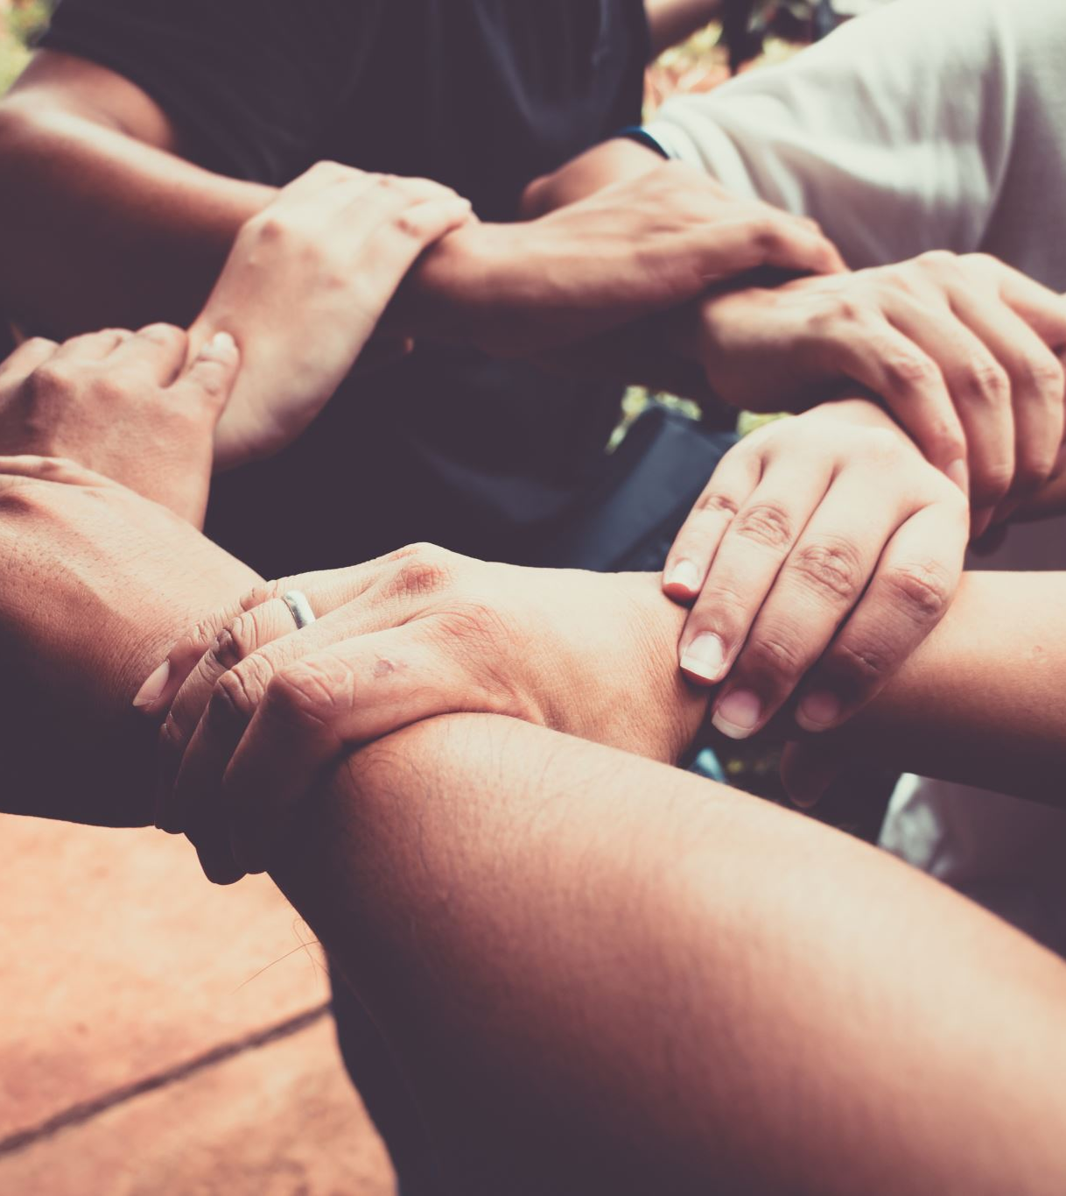
Volunteers needed!!
We cannot run STEM without the help of our volunteers. Here is what is needed for this year…

Slide 21
Fundraising Committee
We would like to host a trivia night and silent auction right here at Randall.
We need a team that works with the board to make this happen.
We also need other ideas and the committee will help make this happen!

Slide 22
Fundraising efforts
Why do we fundraise?
We fundraise to help buy big ticketed supplies like laptops, robots, drones, microscopes, rockets, and much more!
Twice a year, we also like to do Teacher Appreciation as a big thank you to the STEM teachers for their time and efforts.

Slide 23
Academy Volunteer Committee
Helps when need to have parent volunteers at meetings or at events Weekly STEM Academy meeting helper on a rotating basis
Needed this Fall:
Volunteers who know how crochet and can teach students in Animal Allies

Slide 24
Field Trip Committee
We are working out details for this year's trip.
Once we know all the deails, we will need help making it happen!
Renting buses
Forming chaperone groups
Getting snacks

Slide 25
STEM Swag
Extra STEM shirts can now be purchased. This would be a great way to show support for our teams at competitions or at events.
Car Magnets are $5
Items can be purchased from our square site:
Home | RANDALL MIDDLE SCHOOL STEM CLUB BOOSTERS (square.site)

Slide 26
Events
We hope to have a 2nd annual trivia and silent auction right here at Randall in February. More details to follow soon.
Pi Day Pie Sale in November (Potentially)
Field Trip in the Spring

Slide 27
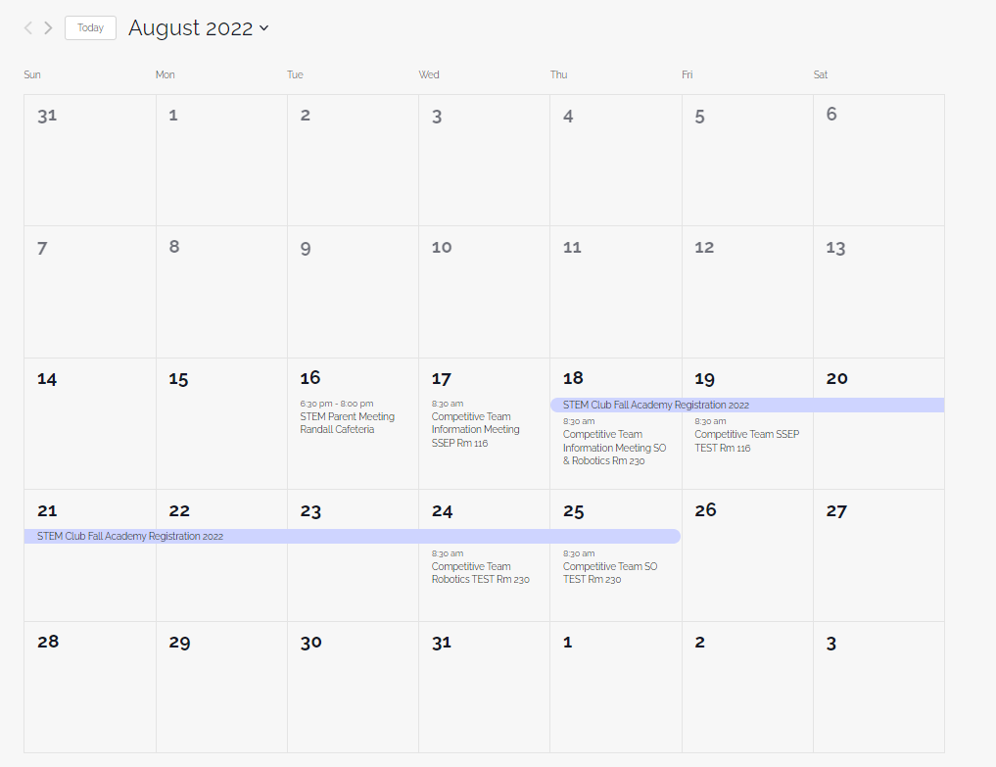
Website
Did you know we have a website? All of the information that was discussed at tonight meeting can be found at: Home - Randall Middle School STEM (randallmsstem.com)
We have an events calendar!

Slide 28
Registration
Students only choose ONE Academy Class. (Either purple OR white.
We will be using square this year.
Please double check all information. We must have the correct student number for students to be in the STEM canvas course. All parents should have a parent canvas account, so they receive all canvas messages.
Registration will be open at 8pm on Aug 21st and close at 8pm on Aug 23th
Please use the wait list option if when you register, you do not know see your child’s first choice academy class. One the waitlist, please provide three choices.

Slide 29
CHECK SPAM!
Square will send you a confirmation email. If you feel like your registration went through but you do not see an email. Please check your spam!!! Square charges us for every transaction. If you register multiple times for the same student AND then request a refund, the STEM club pays multiple fees. Which means less money goes to the kids. ☹ ☹ ☹

Slide 30
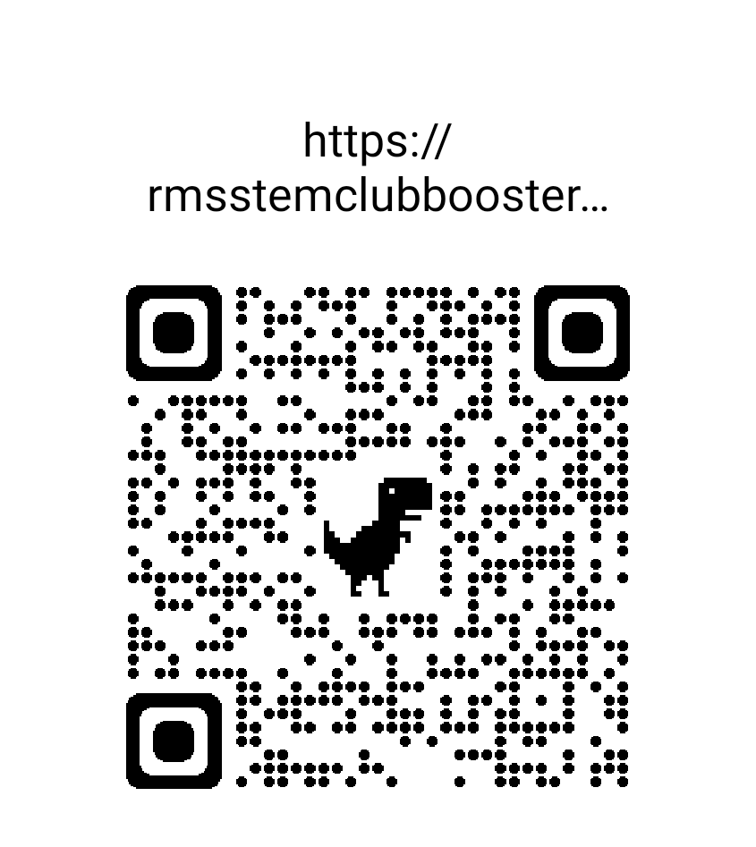
QR code to our square site.
There will be a link to register on our square site at 8pm on Aug 21. Please use this QR code for quick access and to save our square site. This power point with the QR code will be on our website. There are a few QR codes printed out if you wish to take a copy home.

Slide 31
FAQ's
What if the academy class my child wants is not showing when I register? That means the class is full. Please fill out the wait list. If you register for another class, you cannot be switched to different class.
Can I join a competitive team and be in a academy class? Yes, you will have to try out and be selected for a competitive team. For academy, you sign up and pay the dues.
What if I want to be in SSEP AND academy? Sign up for academy on 8/21 to lock in your spot for Thursday STEM. Then you can try out for SSEP on 8/23
How will I get club updates? All students will be added to the canvas STEM course. Parents, please have a canvas account to get the same updates. We also have our website randallmsstem.com and a STEM parent FB page.

